Slide 1
Query Languages

Slide 2


Slide 3


Slide 4


Slide 5


Slide 6

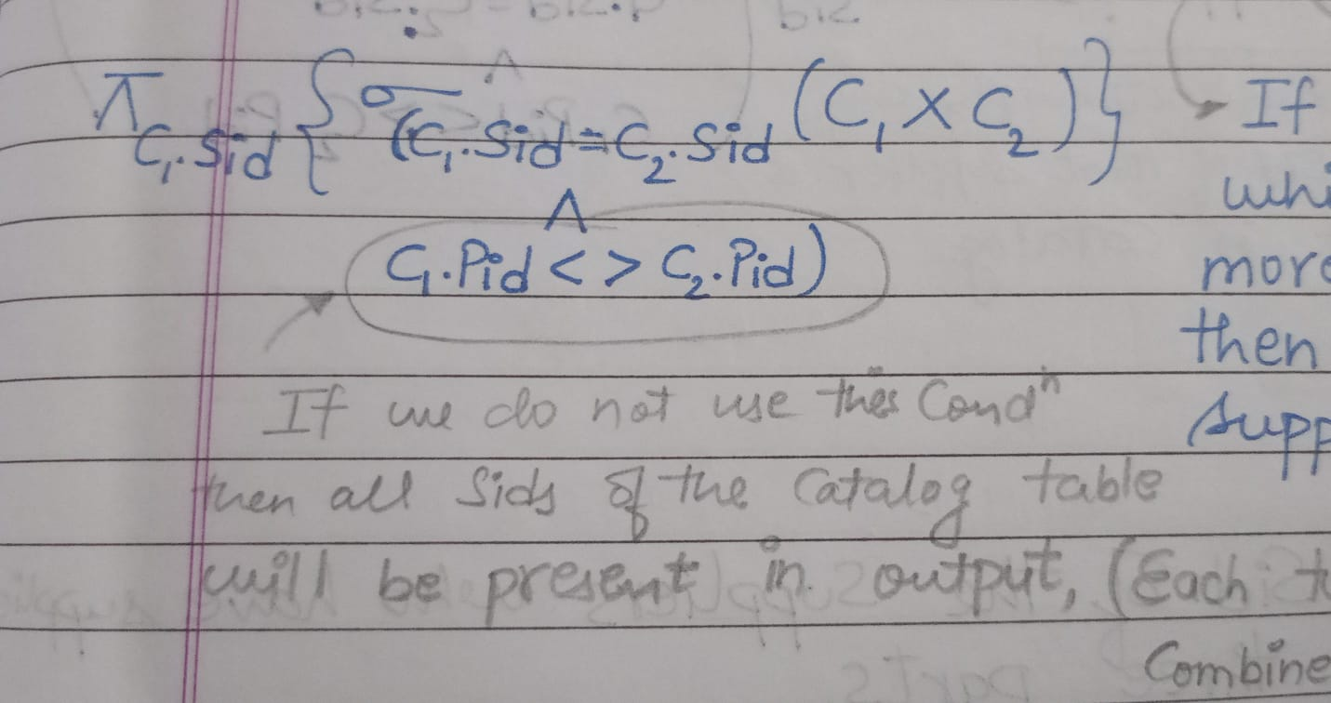

Slide 7

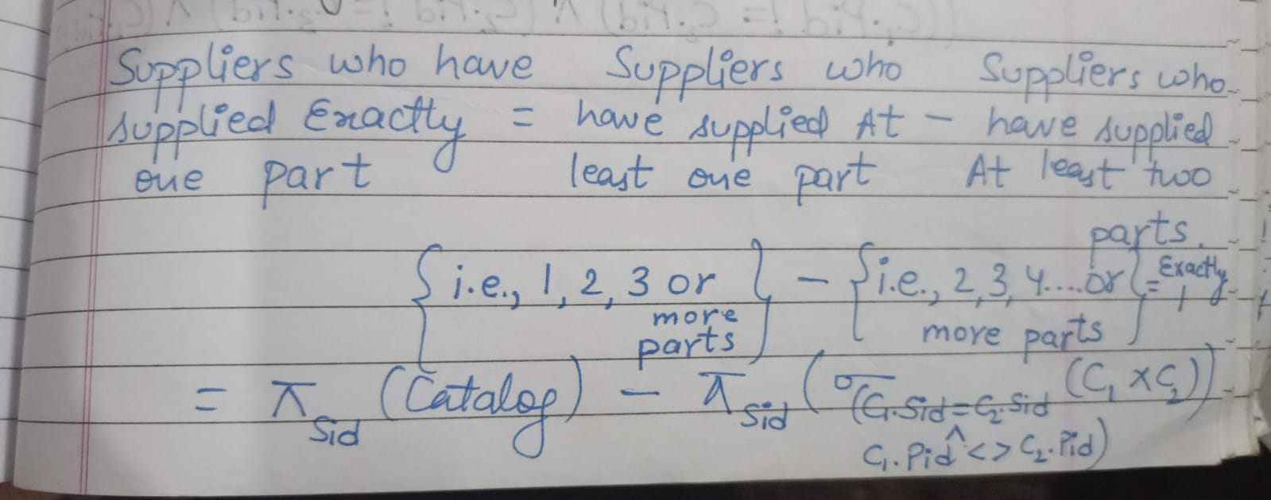

Slide 8

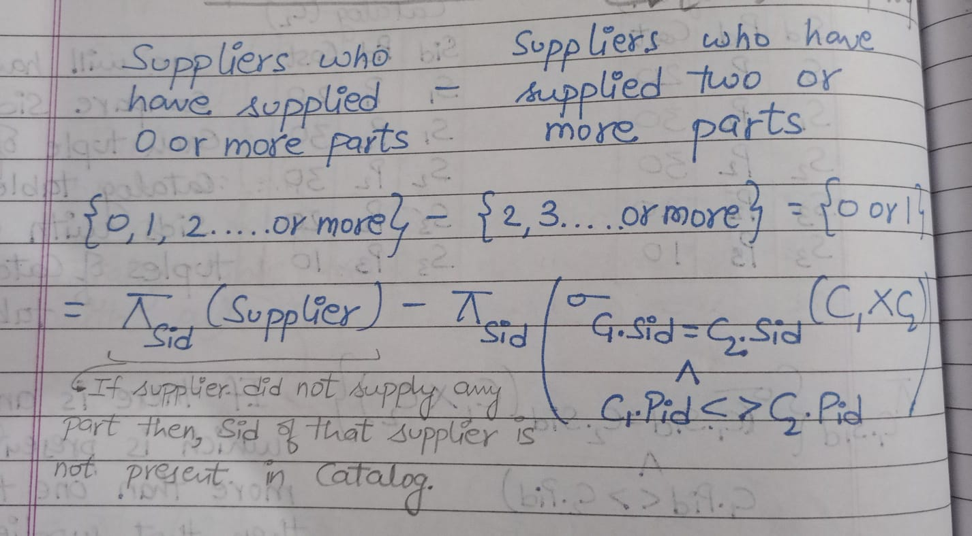

Slide 9
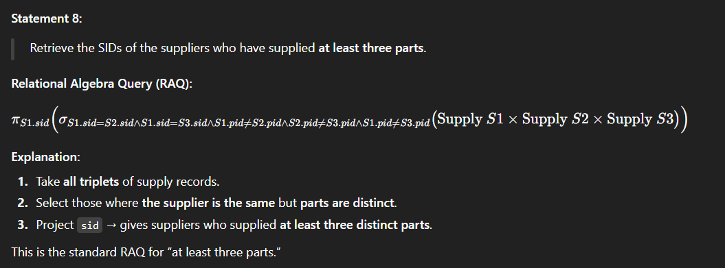


Slide 10


